Slide 1
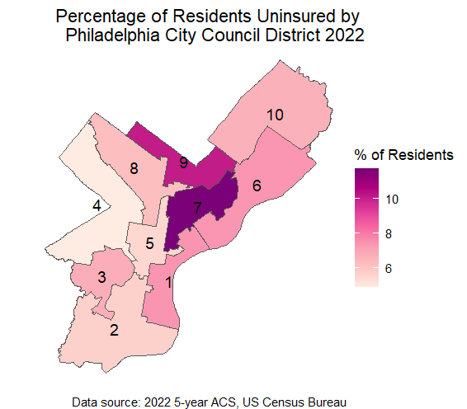
Health Insurance

Slide 2
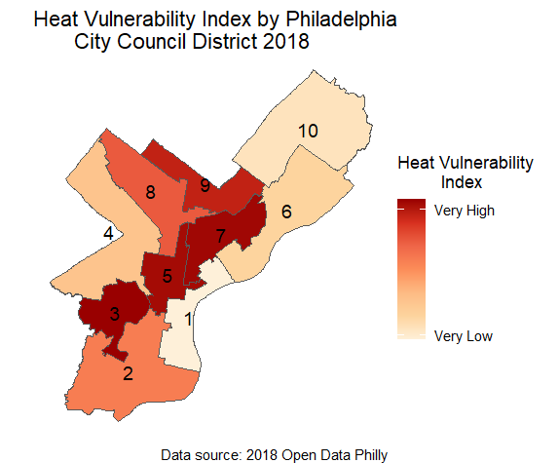
Heat Vulnerability Index

Slide 3
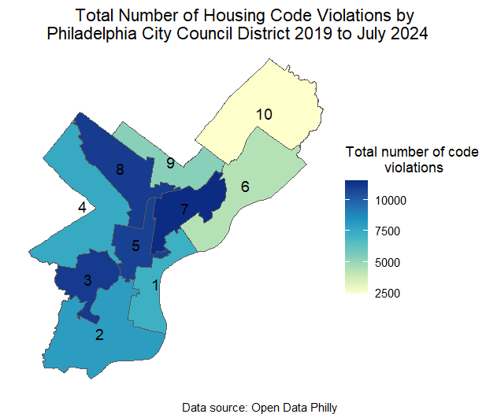
Housing Code Violations

Slide 4
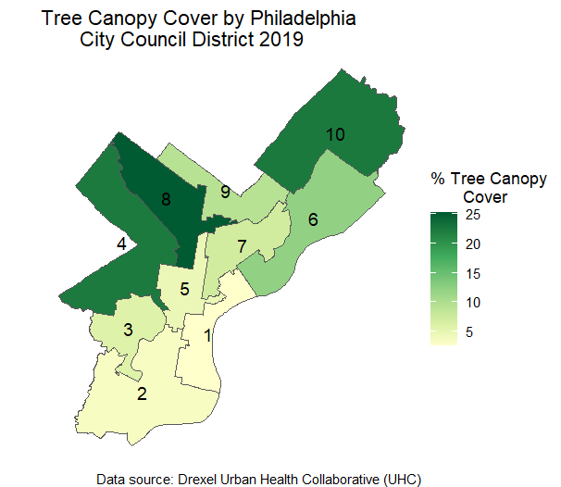
Tree Canopy Cover

Slide 5
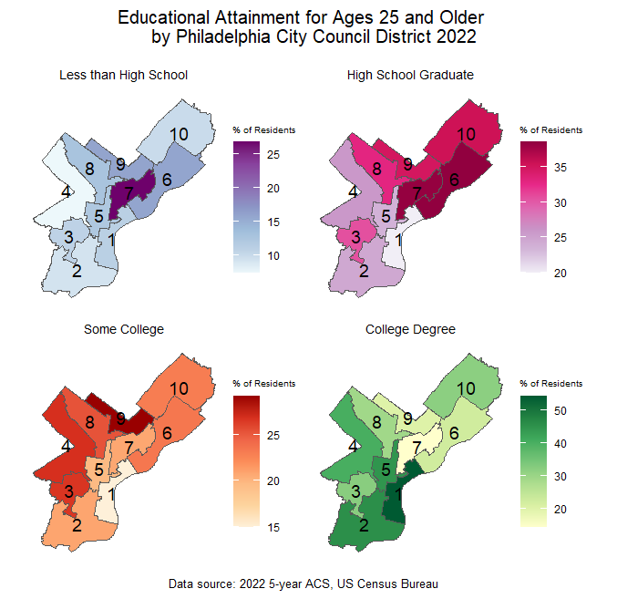
Educational Attainment

Slide 6
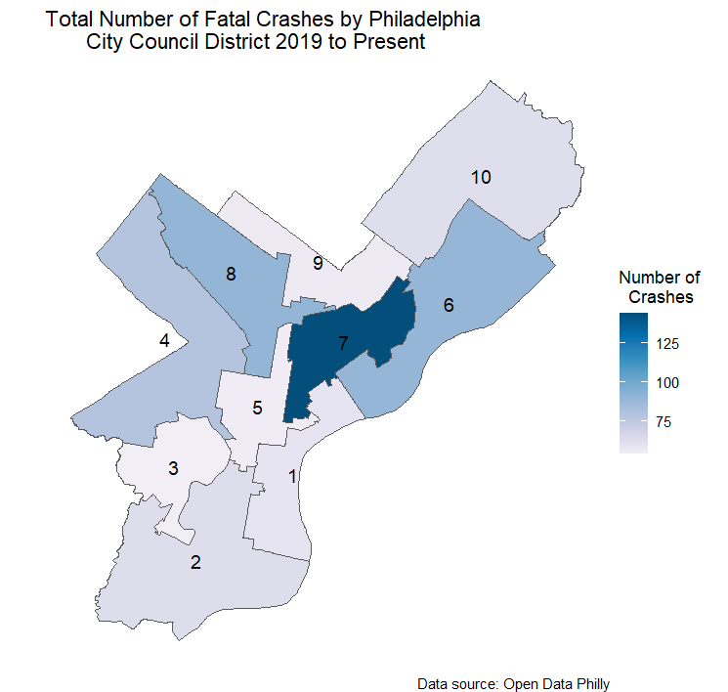
Fatal Crashes

Slide 7
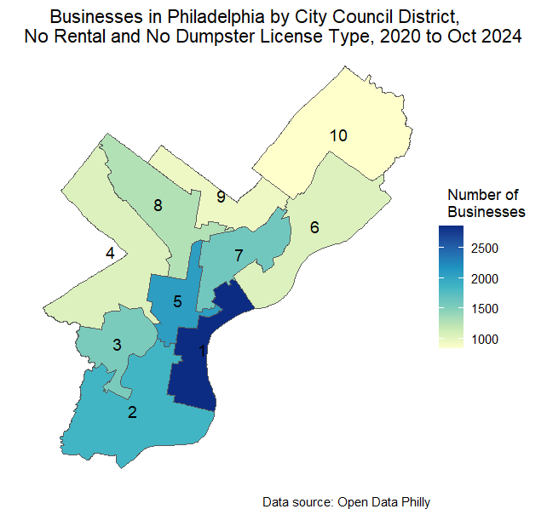
Active Business Licenses (NO RENTAL SHOWN)

Slide 8
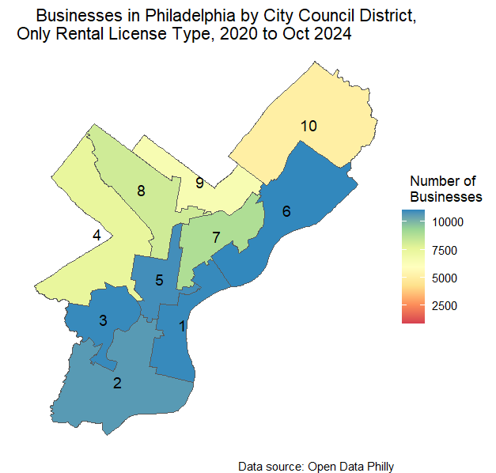
Active Business Licenses (Only RENTAL SHOWN)

Slide 9
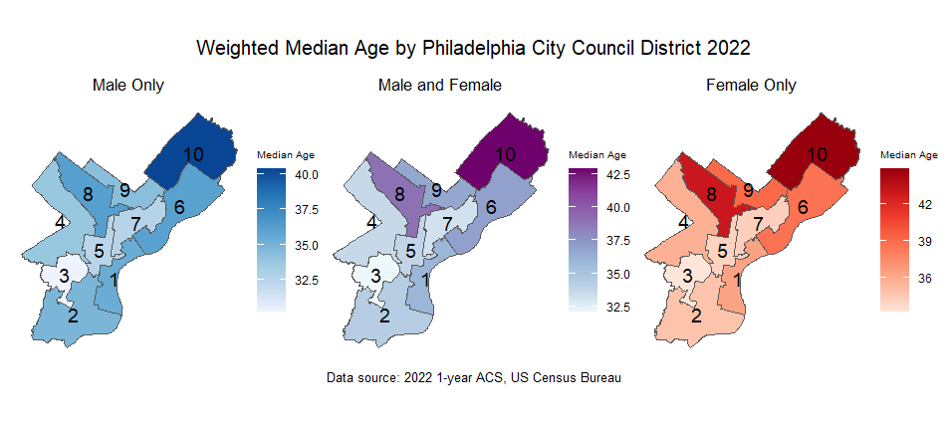
Median Age

Slide 10
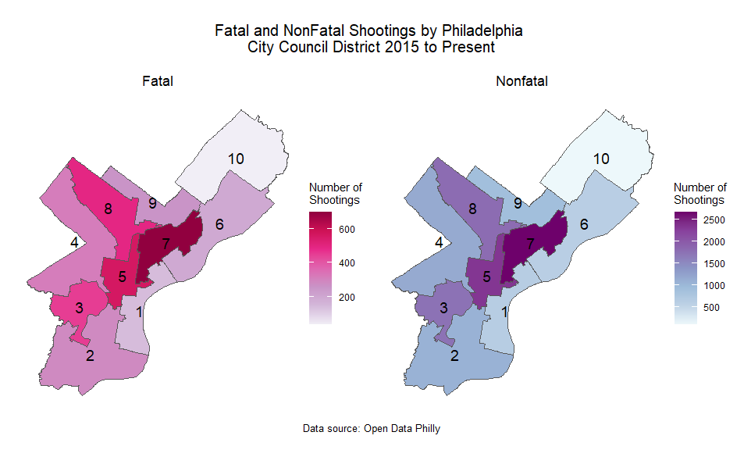
Fatal and Nonfatal Shootings

Slide 11
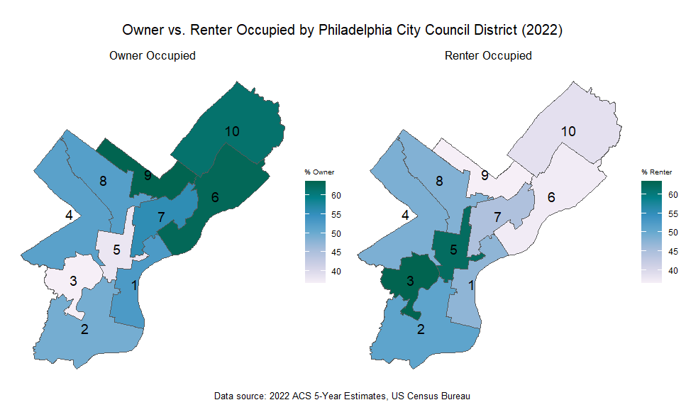
Owner vs. Renter

Slide 12
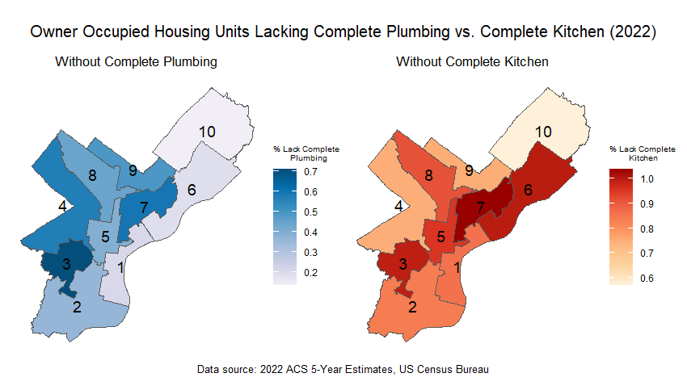
Without Complete Kitchen/Plumbing

